Slide 1



K.RAMAKRISHNAN COLLEGE OF ENGINEERING (AUTONOMOUS)
DESIGN AND DEVELOPMENT OF COMBINED BATTERY CHARGING AND SWAPPING INFRASTRUCTURE FOR FUTURE EVs ENABLED WITH G2V & V2G OPERATION
EE8811-MAIN PROJECT
Team Members:
811519105001 ABINAYA RS
811519105002 AGALYA V
811519105029 NELSHINI P
811519105038 PRIYADHARSHINI M
Under the guidance of
Mr.G.GABRIEL SANTHOSH KUMAR M.E.,(Ph.D.,)
Assistant Professor
Electrical and Electronics Engineering
K. Ramakrishnan College of Engineering,
An Autonomous Institution
Samayapuram, Tiruchirappalli – 621 112

Slide 2

SYNOPSIS
Overview
Introduction
Present Evs Battery Handling Infrastructure
Design of Combined Battery Swapping and Charging Infrastructure
Development of Combined Battery Swapping and Charging Infrastructure
Overview Operation of Combined Battery Swapping and Charging for Evs Enabled G2V & V2G Operation
Conclusion
References

Slide 3
OVERVIEW
The transition to electric vehicles (EVs) has been gradually gaining popularity worldwide, with the aim of addressing environmental pollution and reducing dependence on fossil fuels.
Design and Development of Combined Battery Charging and Swapping Infrastructure for Future EVs Enabled With V2G and V2G operation that proposes a infrastructure for charging and swapping station for Electric Vehicles.
In addition of software application which mainly book the slots for the customers at anywhere at anytime according to their needs.

Slide 4
INTRODUCTION
This project aims to design and develop a comprehensive infrastructure that will benefit the EV users and promote the adoption of electric vehicles. It will provide an efficient and convenient solution to the challenges of EV charging and make the transition to electric vehicles more accessible and accommodating for all.

Slide 5
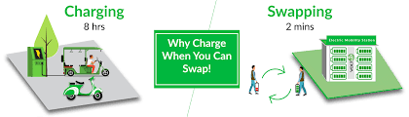
PRESENT EVs BATTERY HANDLING INFRASTRUCTURE
Battery Swapping Station
Battery Charging Station
Currently, there are several existing systems for charging and swapping EV batteries but they are not in an combined manner.

Slide 6

BATTERY SWAPPING STATION
Battery swapping provides a sustainable solution, as the depleted battery packs can be recharged using renewable energy.
Entire swapping system can be integrated with G2V and V2G operation, allowing the system to feed excess electricity back into the grid.
This sustainable power management system reduces carbon emissions and makes the EV charging infrastructure more eco-friendly.

Slide 7
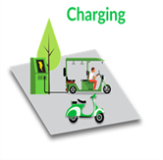
BATTERY CHARGING STATION
The charging ports will be available in multiple locations, providing convenient charging options for EV users.
The charging system will be compatible with most EV models, providing efficient power transfer, which ensures minimum energy loss.

Slide 8
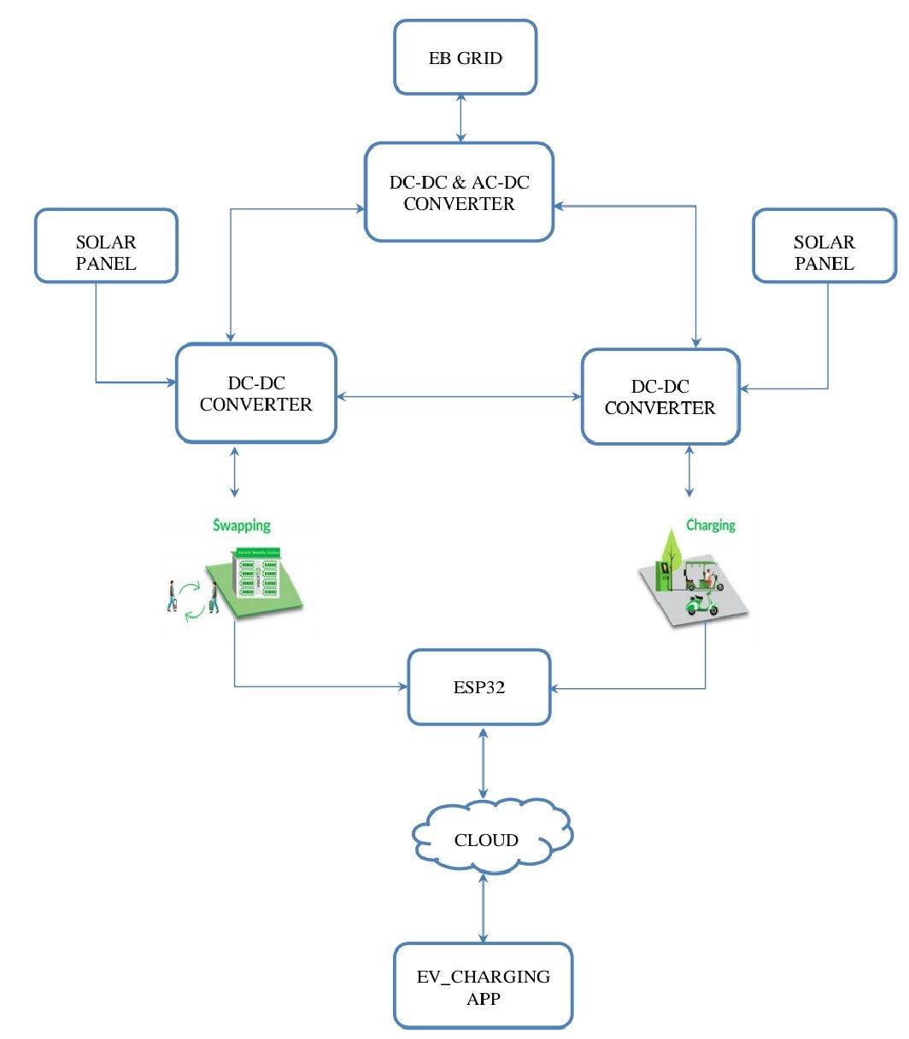
DESIGN OF COMBINED BATTERY CHARGING AND SWAPPPING INTRASTRUCTURE
Block diagram of design and development of battery charging and swapping infrastructure consists of
EB Grid
Solar Panels
DC-DC Converter
ESP32-S3
Clouds
EV_Charging APP
BLOCK DIAGRAM

Slide 9
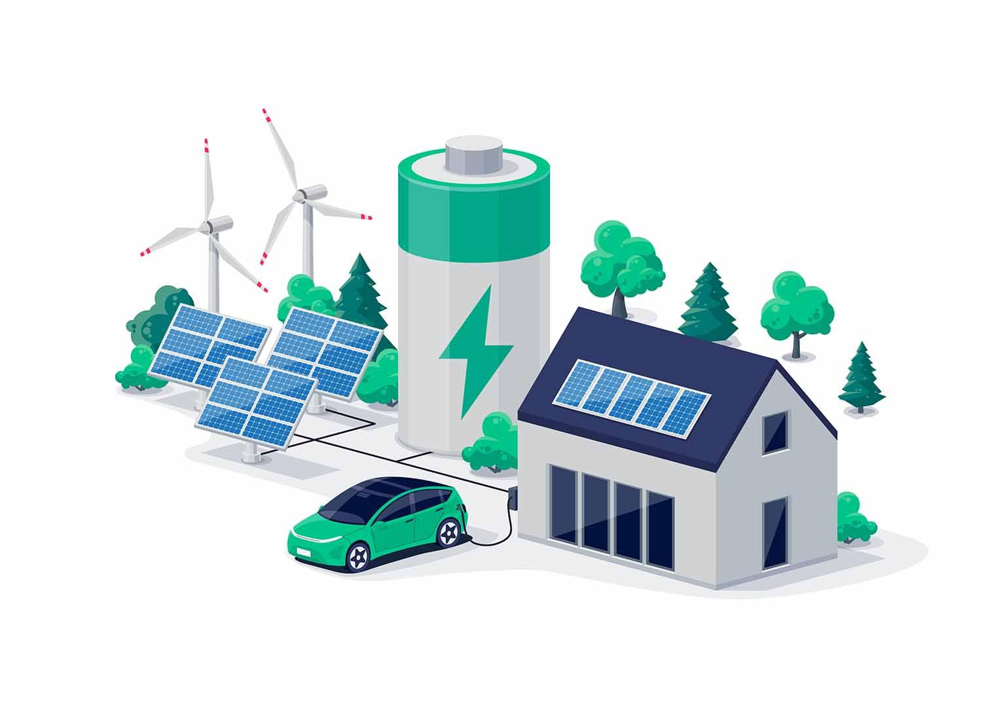
UPGRADE FROM EXISTING SYSTEM
Increase the number of EV charging stations
For instance recharging and swapping infrastructure
App which helps in booking the slots from everywhere according to our need
The most important extra charge from the swapping station is directly connected to the charging station
Reduce power consumption.
Less time management
Easy control aspects applicable to the EV charging and swapping process.

Slide 10
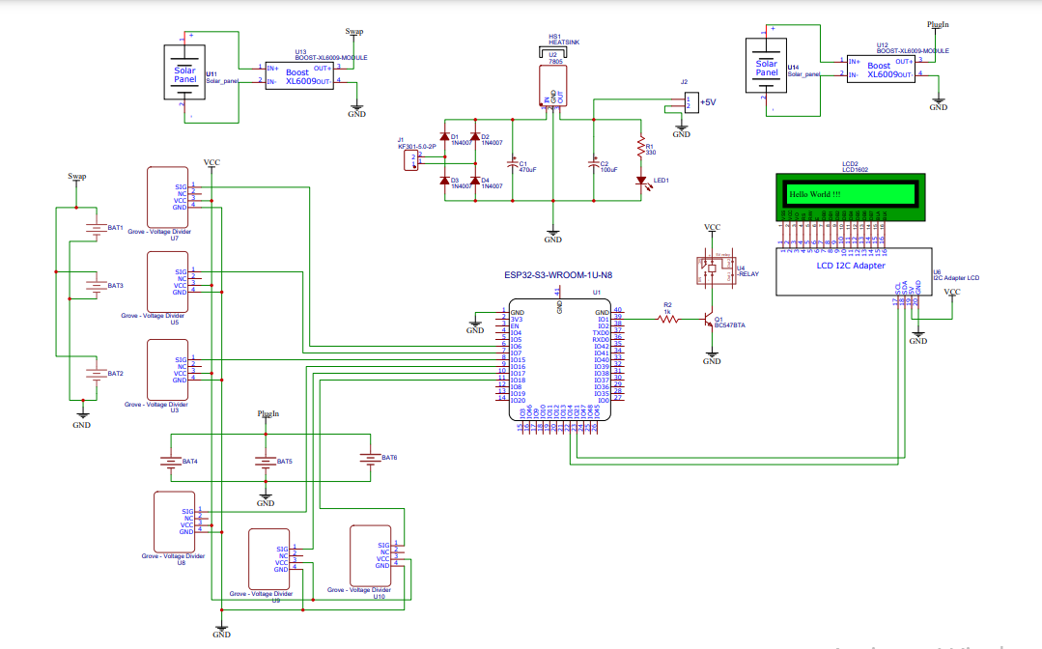
DEVELOPMENT OF COMBINED BATTERY CHARGING AND SWAPPING INFRASTRUCTURE
CIRCUIT DIAGRAM

Slide 11
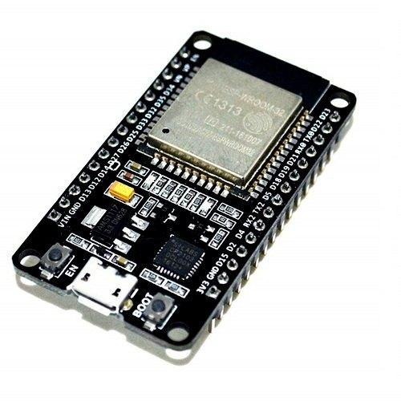

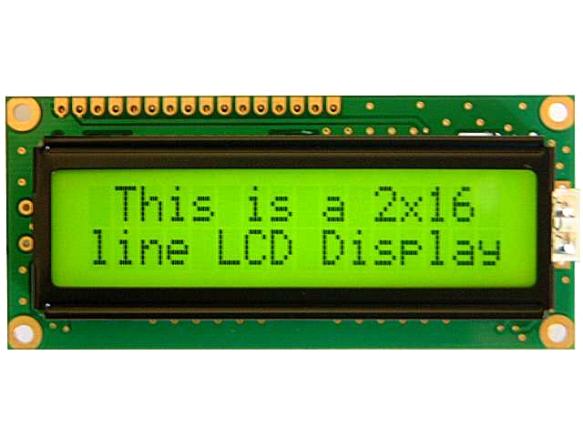


HARDWARE REQUIREMENTS
Power supply
Solar panel
Transformer
DC-DC converter
AC-AC converter
Sensor
Microcontroller ESP32
Battery
Relay
LCD display
SOFTWARE REQUIREMENTS
Arduino IDE

Slide 12
OVERVIEW OPERATION OF COMBINED BATTERY CHARGING AND SWAPPING FOR EVs ENABLED G2V AND V2G OPERATION
STEP 1: The solar panel generates renewable energy
STEP 2: The grid system supplements the charging infrastructure
STEP 3: The power obtained from the grid is stepped down using a step down transformer.
STEP 4: From step down transformer it moves to AC-DC converter.
STEP 5: The power obtained from the PV module was boosted by using a boost converter where DC power is converted to DC by DC-DC converter and given to batteries.

Slide 13
STEP 6: From DC-DC converter the swapping and charging station get charged.
STEP 7: The ESP32 connects with the local network to communicate with charging station controllers, authorization server and display information to the user.
STEP 8: The LCD display shows the details about the power supply
STEP 9: Develop a software application that allows EV drivers to book time slots for charging or swapping their batteries, based on their preferences and availability.
STEP 10: Based on the needs of customers they can either swap their batteries or charge their batteries.
STEP 11: The application can also automatically allocate charging and swapping slots based on the availability of resources.

Slide 14
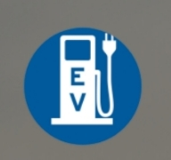
FUNCTION OF SOFTWARE APPLICATION EV_CHARGING
In this application there are three login which helps user as well as admin of the stations
User login
Charging station
Admin login

Slide 15

USER LOGIN
User login generally helps the user to book the slot according to their need

Slide 16

CHARGING STATION
Charging station login helps to view the slots which have been booked by
the customers.
Charging station user has the access to accept the slots.
They can view all the charging station users details, booking slots, and
Report.
They can also update the payment for the slots.

Slide 17

ADMIN LOGIN
Admin login helps to interconnect the charging station.
Admin has the access to add the new charging station.
They can also view all the charging
station users details, booking slots, and report .

Slide 18
BENEFITS OF DESIGN AND DEVELOPMENT OF COMBINED BATTERY SWAPPING AND CHARGING INFRASTRUCTURE
Increased convenience
Reducing range anxiety
Faster charging times
Maximizing battery life
Minimizing CO2 emissions

Slide 19
CONCLUSION
Electric vehicle infrastructure is essential for the growth and adoption of electric vehicles in the modern world. The availability of charging and swapping stations for electric vehicles ensures they can be used as convenient and practical alternatives to traditional gasoline-powered vehicles. Moreover, utilizing solar panel power for charging and swapping stations is also cost-effective and sustainable in the long run, as the cost of solar panel installation and maintenance continuously decreases.

Slide 20
REFERENCES
W. Lee, K. Kim, J. Park, J. Kim, and Y. Kim, ‘‘Forecasting solar power using long-short term memory and convolutional neural networks,’’ IEEE Access, vol. 6, pp. 73068–73080, 2018
S. K. Kollimalla and M. K. Mishra, ‘‘A novel adaptive P&O MPPT algorithm considering sudden changes in the irradiance,’’ IEEE Trans. Energy Convers., vol. 29, no. 3, pp. 602–610, Sep. 2014
B. Subudhi and R. Pradhan, ‘‘A comparative study on maximum power point tracking techniques for photovoltaic power systems,’’ IEEE Trans. Sustain. Energy, vol. 4, no. 1, pp. 89–98, Jan. 2013

Slide 21

Thank you!

